Slide 1
COMP 110/L Lecture 18
Maryam Jalali Some slides adapted from Dr. Kyle Dewey

Slide 2
Outline
JUnit fail()
More two-dimensional array examples

Slide 3
JUnit fail()

Slide 4
fail()
Triggers immediate test failure

Slide 5
fail()
Triggers immediate test failure
import static org.junit.Assert.fail;
Notes:
-Need this import at the beginning of the program

Slide 6
fail()
Triggers immediate test failure
import static org.junit.Assert.fail;
@Test
public void testSomething() { if (someFailureCondition) {
fail();
}
}
Notes:
-We can then use fail() in tests

Slide 7
Example
FailExample.java
FailExampleTest.java

Slide 8
fail() Utility
Some test failures cannot be easily phrased as one value equals another value
Occasionally more convenient
We can define our own assertEquals() and assertArrayEquals() using fail()

Slide 9
Some cases where it is useful:
1- mark a test that is incomplete, so it fails and warns you until you can finish it
2- making sure an exception is thrown:

Slide 10
There are three states that your test case can end up in
Passed: The function under test executed successfully and returned data as expected
Not Passed: The function under test executed successfully but the returned data was not as expected
Failed: The function did not execute successfully and this was not
intended (Unlike negative test cases that expect a exception to occur).
If you are using eclipse there three states are indicated by a Green, Blue and red marker respectively.
We can use the fail operation for the third scenario.
e.g.:
public Integer add(integer a, Integer b) { return new Integer(a.intValue() + b.intValue())}
Passed Case: a = new Interger(1), b= new Integer(2) and the function returned 3
Not Passed Case: a = new Interger(1), b= new Integer(2) and the function returned any value other than 3
Failed Case: a = null , b = null and the function throws a NullPointerException

Slide 11



Two-Dimensional Arrays
» Thus far, you have used one-dimensional arrays to model linear collections of elements.You can use a two-dimensional array to represent a matrix or a table.
Declaring Variables of Two-Dimensional Arrays and Creating Two-Dimensional Arrays
» Here is the syntax for declaring a two-dimensional array:
dataType[][] arrayRefVar;
» As an example, here is how you would declare a two- dimensional array variable matrix of int values:
int[][] matrix;

Slide 12
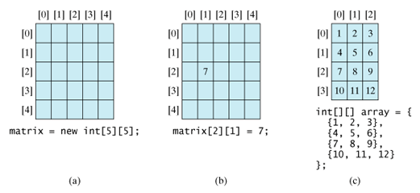
Two-Dimensional Arrays
» You can create a two-dimensional array of 5 by 5 int values and assign it to matrix using this syntax:
matrix = new int[5][5];
» Two subscripts are used in a two-dimensional array, one for the row, and the other for the column. As in a one-dimensional array, the index for each subscript is of the int type and starts from 0.

Slide 13
Two-Dimensional Arrays
» You can create a two-dimensional array of 5 by 5 int values and assign it to matrix using this syntax:
matrix = new int[5][5];
» Two subscripts are used in a two-dimensional array, one for the row, and the other for the column. As in a one-dimensional array, the index for each subscript is of the int type and starts from 0.

Slide 14

Two-Dimensional Arrays
» You can also use an array initializer to declare, create, and initialize a two-dimensional array. For example, the following code in (a) creates an array with the specified initial values, This is equivalent to the code in (b).

Slide 15
Two-Dimensional Arrays
Obtaining the Lengths of Two-Dimensional Arrays
» A two-dimensional array is actually an array in which each element is a one-dimensional array.The length of an array x is the number of elements in the array, which can be obtained using x.length. x[0], x[1], ..., and x[x.length-1] are arrays.Their lengths can be obtained using x[0].length, x[1].length, ..., and x[x.length-1].length.
» For example, suppose x = new int[3][4], x[0], x[1], and x[2] are one- dimensional arrays and each contains four elements, x.length is 3, and x[0].length, x[1].length, and x[2].length are 4.

Slide 16
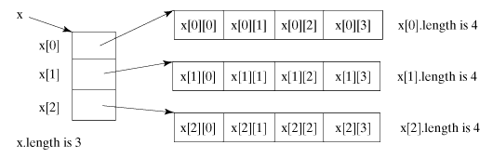
Two-Dimensional Arrays
Obtaining the Lengths of Two-Dimensional Arrays
» A two-dimensional array is a one-dimensional array in which each element is another one-dimensional array.

Slide 17
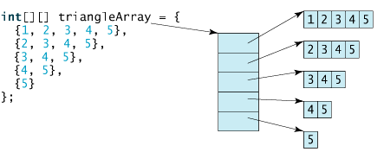
Two-Dimensional Arrays
Ragged Arrays
» Each row in a two-dimensional array is itself an array. Thus the rows can have different lengths. An array of this kind is known as a ragged array. Here is an example of creating a ragged array:
» As can be seen, triangleArray[0].length is 5, triangleArray[1].length is 4, triangleArray[2].length is 3, triangleArray[3].length is 2, and
triangleArray[4].length is 1.

Slide 18
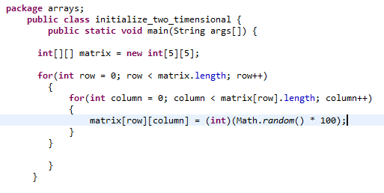
Two-Dimensional Arrays
Processing Two-Dimensional Arrays
» (Initializing arrays with random values) The following loop initializes the array with random values between 0 and 99:

Slide 19
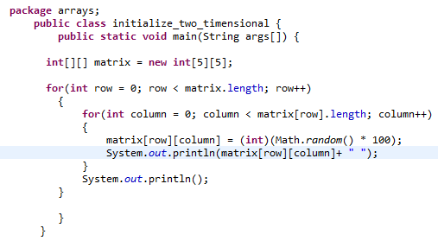
Two-Dimensional Arrays
Processing Two-Dimensional Arrays
» (Printing arrays) To print a two-dimensional array, you have to print each element in the array using a loop like the following:

Slide 20
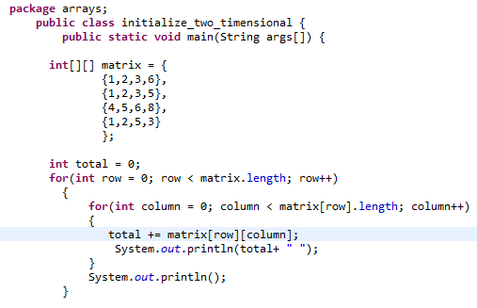
Two-Dimensional Arrays
Processing Two-Dimensional Arrays
» (Summing all elements) Use a variable named total to store the sum. Initially total is 0. Add each element in the array to total using a loop like this:

Slide 21
More 2D Array Examples
PrintRow2D.java
PrintCol2D.java

